Slide 1

NORTH BENGAL INTERNATIONAL UNIVERSITY
Enterprise Management Systems

Slide 2

EMS is concerned with control, monitoring and the management of IT infrastructure and applications in order to optimize IT service delivery in Company.
EMS is wide information system designed to coordinate all the resources, information and activities needed to complete business processes.
Enterprise – an entire company, everything, all-inclusive
Management – The monitoring and controlling of entities
Systems – Information Technology Infrastructure, hardware and software, data, information, and processes

Slide 3

Enterprise software is any software used in large organizations (whether business or government).
It is considered to be an essential part of a computer-based information system, and it provides business-oriented tools such as online payment processing and automated billing systems.
Enterprise software is also referred to as enterprise application software.

Slide 4

ERP is business process management software that allows an organization to use a system of integrated applications to manage the business and automate back office functions.
ERP software integrates all facets of an operation, including product planning, development, manufacturing processes, sales and marketing.
Some of ERP’s functions include:
  Bookkeeping & Accounting
  Human Resource Management
  Planning Production
  Supply Chain management

Slide 5

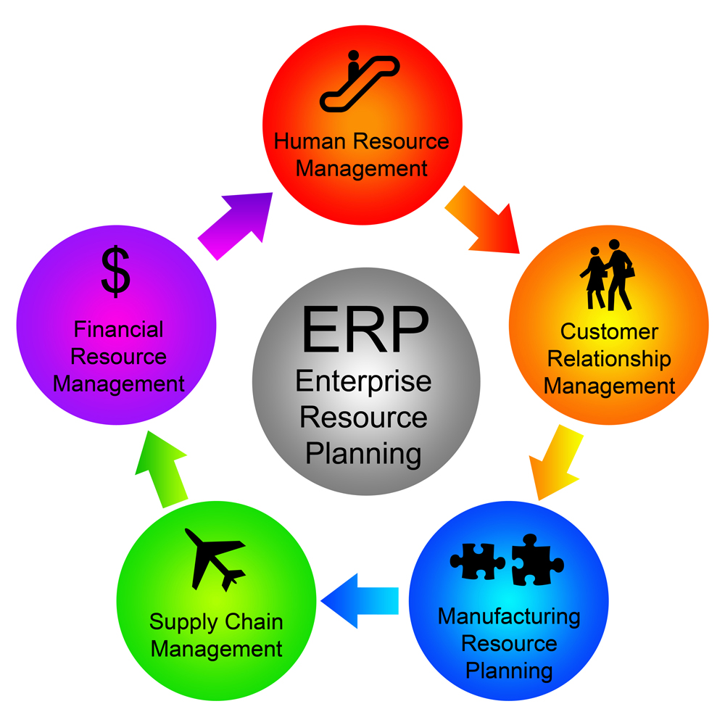

Slide 6
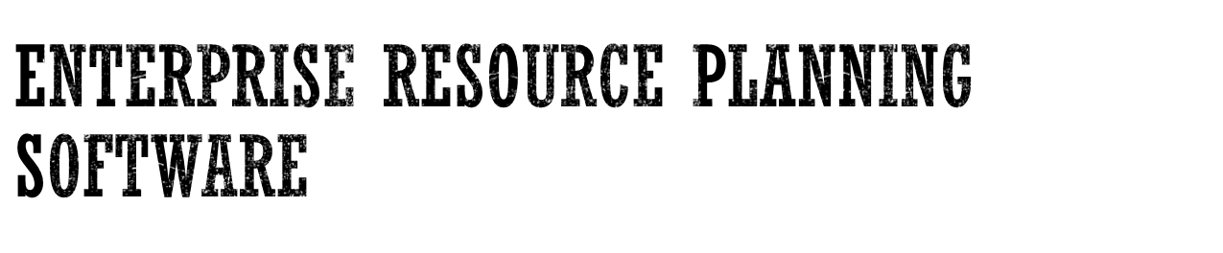
It helps an organization to integrate information flows, operations and processes all resources accessible, for example, materials, work force, machine and money.
The focus of ERP is on resource management within constraints to maximize the return on investment.
These data are then stored in a unified database, which are the key for the success of this software solution.
The ERP package design is built on the principle of Best Practices.
ERP Software: SAP, Supply Chain Management, CRM
Notes:
The most demanding and successful solution for the modern business organization is an Enterprise Resource Planning software.

Slide 7

A supply chain is the system of organizations, people, activities, information and resources involved in moving a product or service from supplier to customer.
Supply chain activities transform raw materials and components into a finished product that is delivered to the end customer.

Slide 8








Supplier
Manufacturer
Distributor
Retailer
Customers

Slide 9
Supply Chain Management is the design and management of processes across organizational boundaries with the goal of matching supply and demand in the most cost effective way.
Supply
Demand
Matching Supply and Demand

Slide 10

Customer Relationship Management is a strategy for managing all your company’s interactions with current and prospective customers.
CRM formation of bonds between a company and its customers.
CRM enables your company to increase productivity, close more business, and improve customer satisfaction and retention.

Slide 11
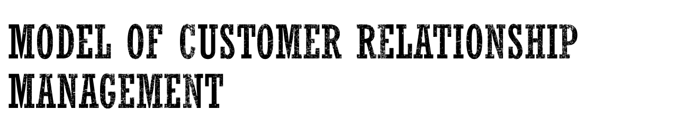
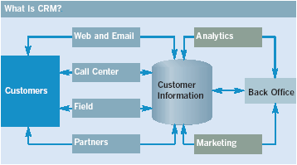

Slide 12
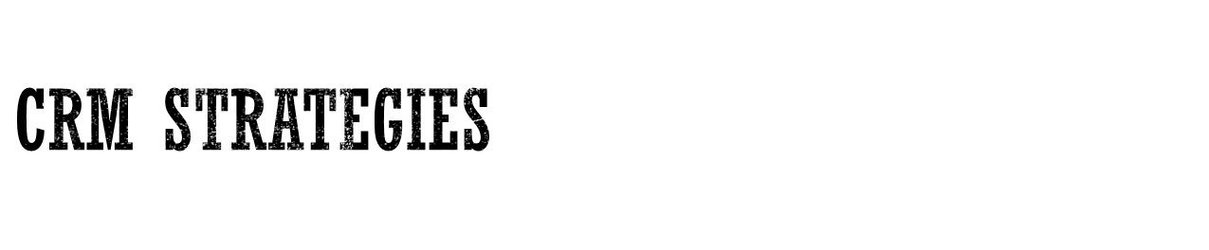
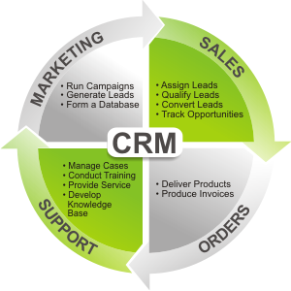

Slide 13
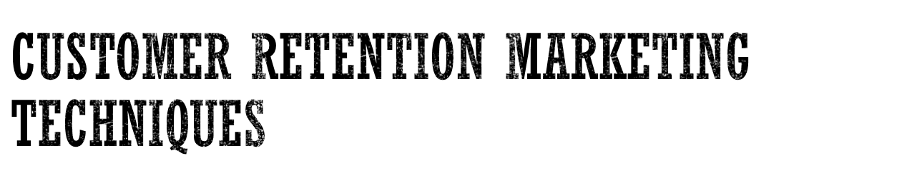
Customization: Changing the product (not just the marketing message) according to user preferences
Customer co-production: Allows the customer to interactively create the product
Customer service tools include:
  Frequently asked questions
  Real-time customer service chat systems
  Automated response systems

Slide 14

Centralized customer interaction
Improved customer support and satisfaction
High rate of customer retention
Increase revenue and referrals from existing customers
Improve your products/services
Measure and optimize your performance
Boost new business

Slide 15

Enterprise information management (EIM) is a set of business processes, disciplines and practices used to manage the information created from an organization's data.
EIM initiatives seek to build efficient and agile data management operations with capabilities for information creation, capture, distribution and consumption.
The goal is to provide and preserve information as a business asset that remains secure, easily accessible, meaningful, accurate and timely.

Slide 16

EITM is a strategy conceived and developed by Computer Associates International which details how organizations can transform the management of IT in order to maximize business value.
Strategy for increasing the business relevance of the IT function, EITM considers the need for IT organizations to start operating as a service-based business.
Ensuring investments are prioritized according to business strategy and that operational efficiencies can be more quickly realized and costs reduced when IT processes are integrated and automated.
Notes:
CA Inc: Computer Associates International

Slide 17

Enterprise IT Management was developed in response to a growing need by IT organizations to gain more value from investments made in IT capabilities, infrastructure and resources.
EITM proposes a set of capabilities that enable IT to better govern, manage and secure the IT services delivered to the business.
IT/IS as asset, “strategic weapon”, “nervous system” (strategic level) Vs tool, commodity (operational level)
Notes:
Management of information technology (IT) and information systems (IS, systems) is similar to “Management Information Systems” (MIS) which Utilizing IT/IS and information these support to solve business problems and support organizational performance.

Slide 18

Enterprise information system (EIS) is a system that serves an entire enterprise or at least two functional departments in:
  Business intelligence (BI)
  Enterprise resource planning (ERP)
  Knowledge management (KM)
  Partner relationship management (PRM)
  Business process management (BPM)
  Customer relationship management (CRM)

Slide 19

Help to unify the firm’s structure and organization: One organization
Management: Firm wide knowledge-based management processes
Technology: Unified platform
Business: More efficient operations & customer-driven business processes
Supporting the major business functions: sales and marketing, manufacturing and production, finance and accounting, and human resources

Slide 20
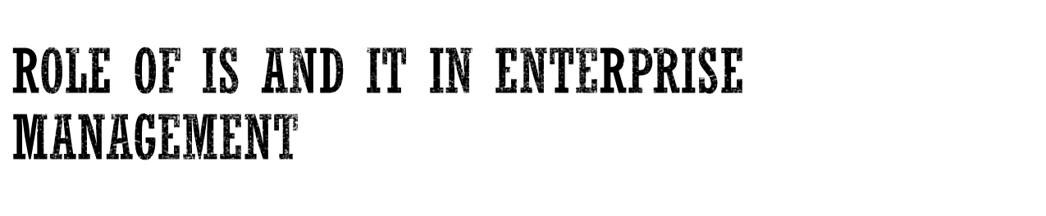
Reduce Costs/ Improve Productivity
Improve Customer Satisfaction/ Loyalty
Create Competitive Advantage
Generate growth
Streamline Supply Chain
Global Expansion

Slide 21

Identify and Integrate best and most successful ways to change an enterprise

Slide 22
Two aspects
  Understand new mechanisms
    New ways of organizing work
    New Corporate Architectures must be understood
  Understand methods that can change an enterprise

Slide 23


What should the enterprise be?
How do we get there from here?

Slide 24

Enterprise Engineering is integrated set of disciplines for building or changing an enterprise, its processes, and systems.
It integrates the most powerful change methods and makes them succeed.
The goal is a human-technological partnership of maximum efficiency in which learning takes place at every level.

Slide 25

Identify and integrate the most valuable and successful ways to change an enterprise, and to take them into a professional discipline with a teachable methodology and measures of effectiveness.

Slide 26

“Doing your best is not enough.”
W. Edwards Deming
You must know what to do, how to do it and be willing to pay the price to do it.

